Slide 1
Data-Driven Strategies to Reduce Employee Absenteeism
Student Name : Rohan Ashok Gonabal
Course 9 : Predictive Modelling using Machine Learning
Batch Code : DA464S46
Project Guide : Komilla Bhatia

Slide 2
Problem Statement
Employee absenteeism is a critical issue affecting organizational productivity, workforce planning, and operational efficiency. Unplanned or frequent absences can lead to reduced output, increased workload for present employees, and overall decline in team performance. By leveraging machine learning models and exploratory data analysis, the goal is to help management make informed decisions that address the root causes of absenteeism and implement effective HR strategies.

Slide 3
Objectives
Identify employees who frequently miss work and suggest appropriate actions.
What can the management do to reduce absenteeism
Which ID of employees should be encouraged for low absenteeism
What are the top 5 reasons for low absenteeism
The ID of the employees who are frequently absent is achieving their target to what level.

Slide 4
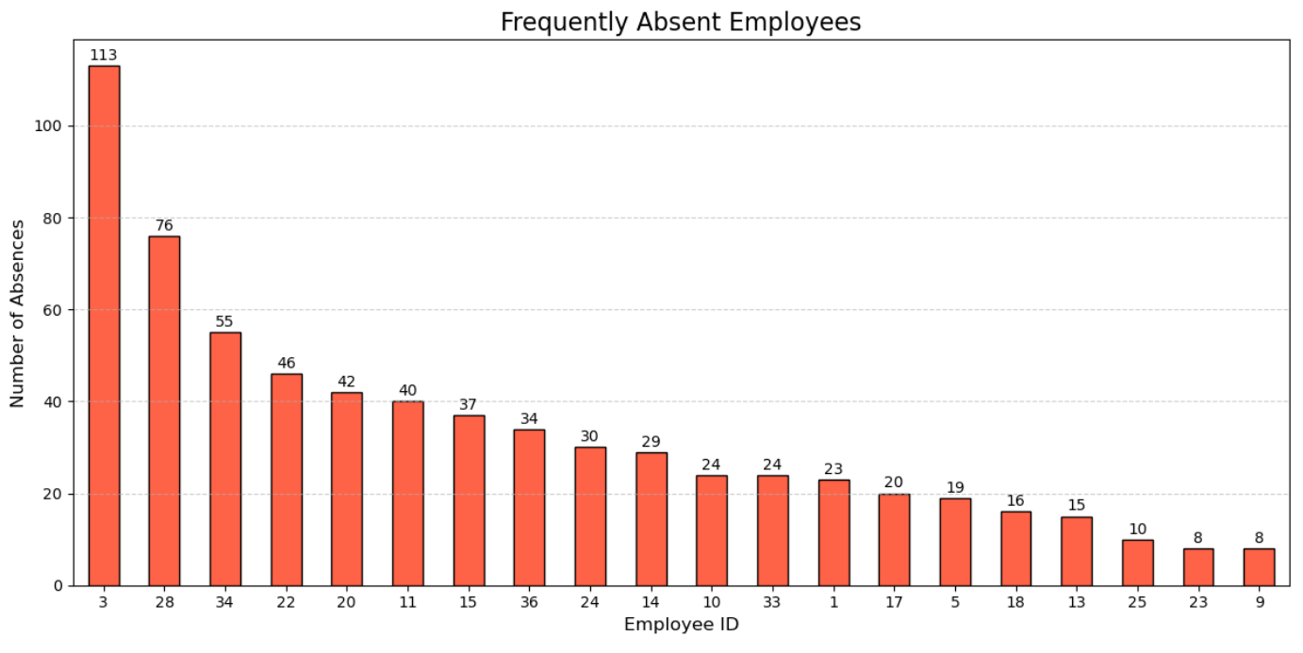
EDA
1. Frequently Absent Employees
Interpretation:
Employee ID 3 has the most number of Absences.

Slide 5
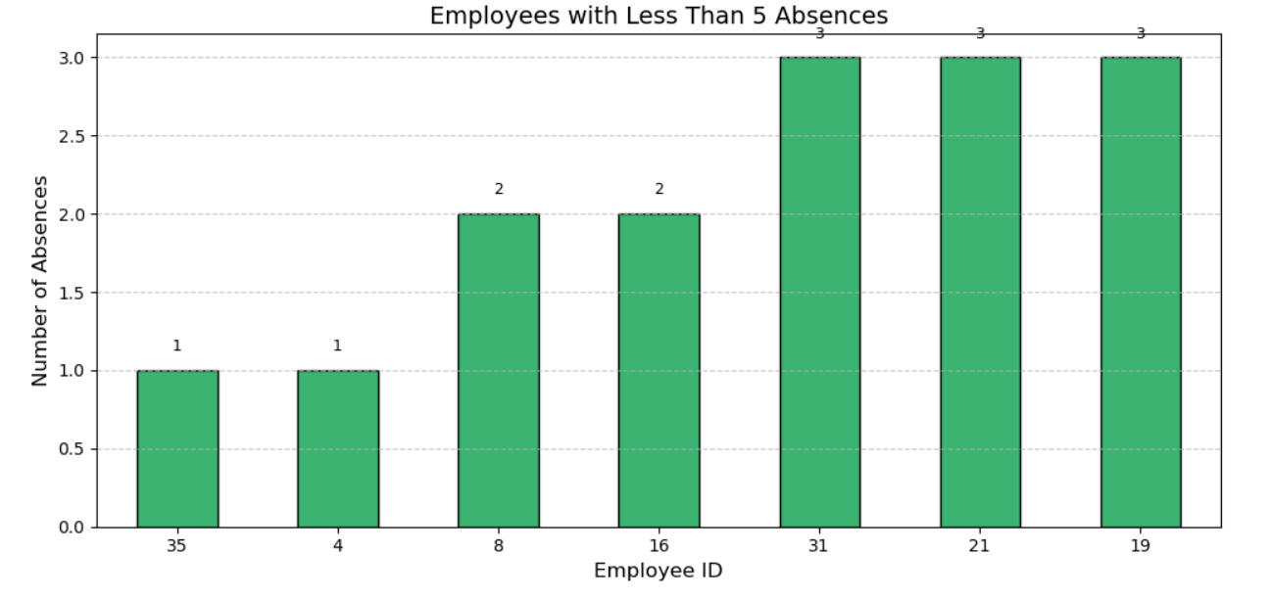
EDA
1. Employees with Less Absences
Interpretation:
Employee ID 35 has the Less number of Absences.

Slide 6
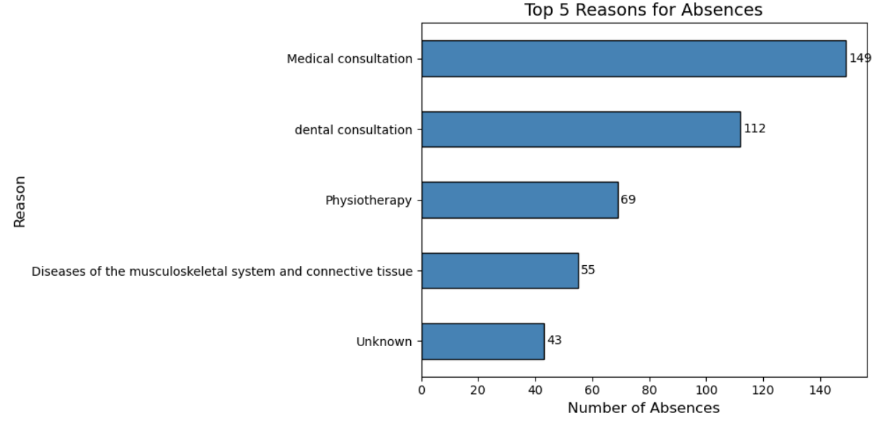
EDA
1. Top 5 Reasons for Absences
Interpretation:
Medical Consultation has more reasons for Absences.

Slide 7
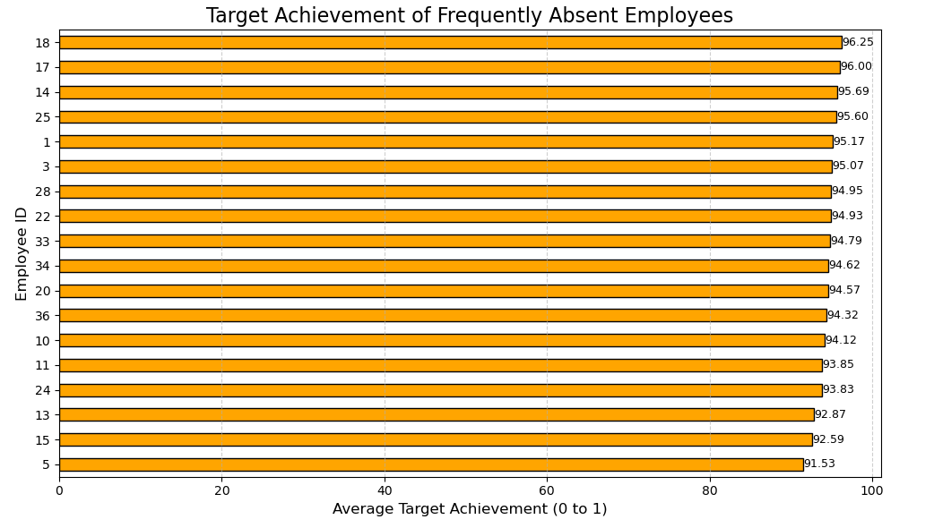
EDA
1. Target Achievement of Frequently Absent Employees
Interpretation:
Target Achievement of Frequently Absent Employees

Slide 8
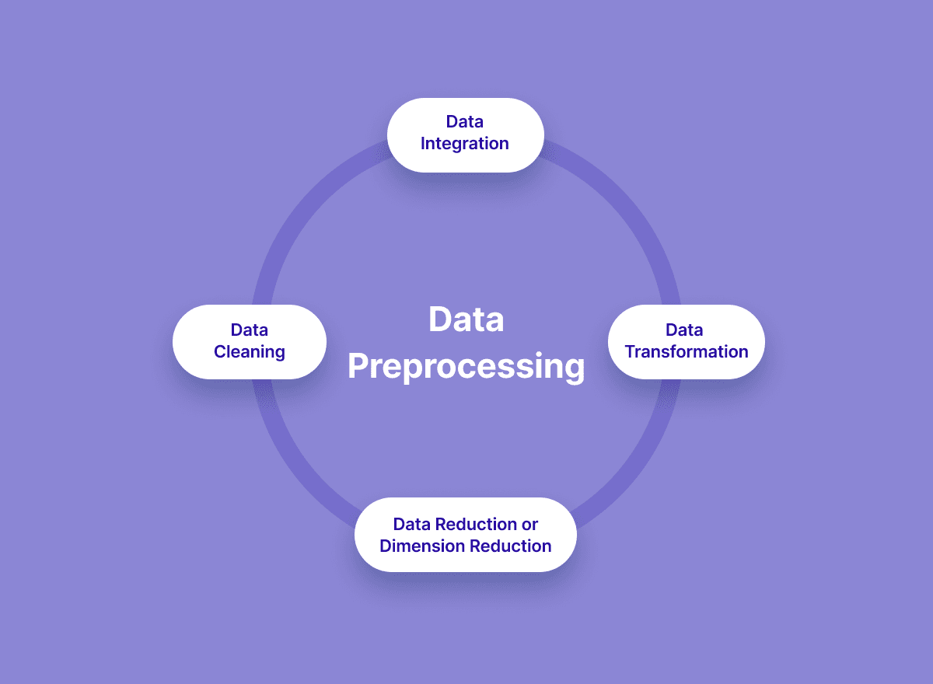
Data Preprocessing
Data Cleaning
Improving data quality involves handling missing values, removing duplicates, and correcting errors and outliers.
Data Integration
Combining data from multiple sources into a unified dataset.
Data Transformation
Converting data into a suitable format or structure for Machine Learning algorithms
(e.g., Scaling, encoding).
Data Reduction
Reducing the volume or dimensionality of data while preserving essential information, making analysis more efficient.

Slide 9
Linear Regression Model
Identify the independent columns
Reason for absence, Day of the week, Workload Average/day, Disciplinary failure, Son, and Social drinker
Dependent or Target column
Absenteeism time in hours
Training and Testing Data are Split into 70% and 30%
After testing the model Results are :
Training Performance:
R² (R-squared): 0.245 → The model explains 24.5% of the variance in the training data.
MSE (Mean Squared Error): 0.680
RMSE (Root Mean Squared Error): 0.825
MAE (Mean Absolute Error): 0.625
Testing Performance:
R² (R-squared): 0.261 → The model explains 26.1% of the variance in the testing data.

Slide 10
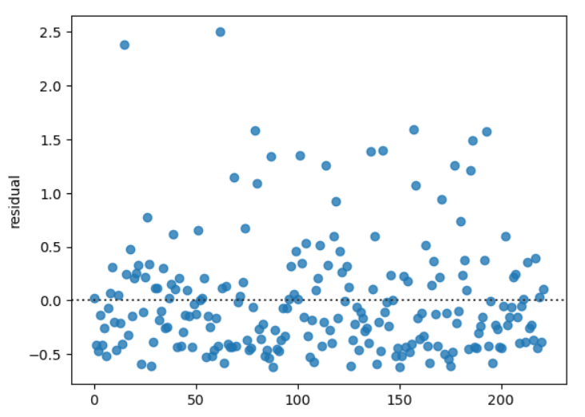
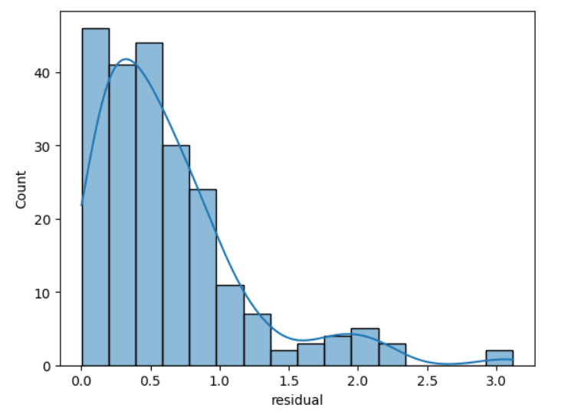
Linear Regression Model
Checking Residual Values

Slide 11
K-Means Model
Independent column: Absenteeism time in hours
After plotting Different numbers of clusters, we finalized with 2 clusters or 2 groups called Frequently Present and Frequently Absent
Silhouette Score: 74 %
Davies-Bouldin Score: 0.2307
Calinski-Harabasz Score: 1233.32

Slide 12
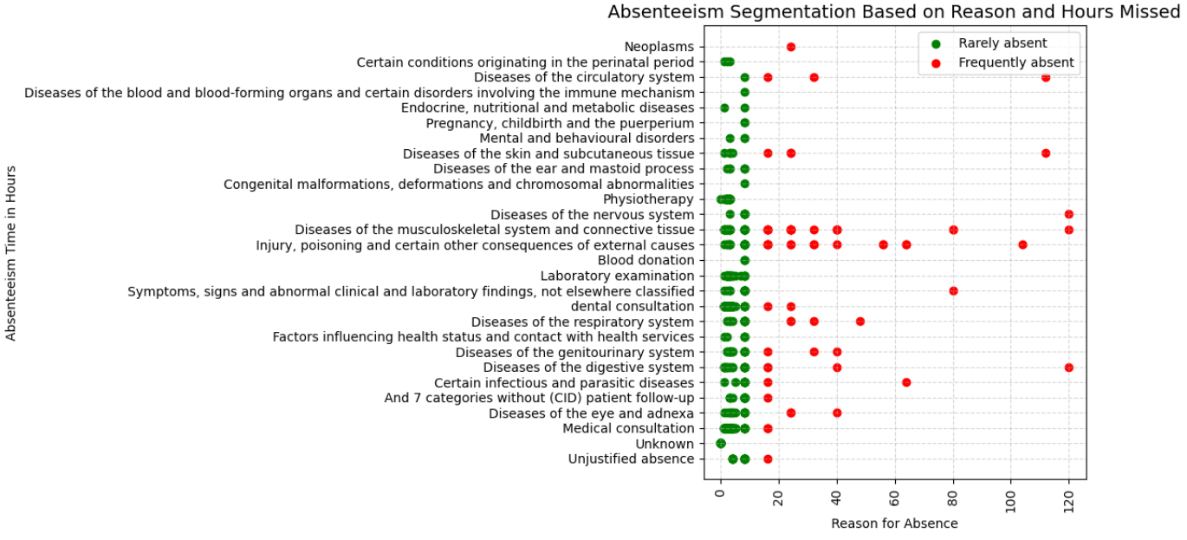
K-Means Model
Cluster or Groups Based on Absent Hours.

Slide 13
Logical Regression Model
Independent column
Absenteeism time in hours
After plotting Different numbers of clusters, we finalized with 2 clusters or 2 groups called Frequently Present and Frequently Absent
Accuracy Score: 92.79%
F1 Score: 89 %
precision 93 %
Recall 100%

Slide 14
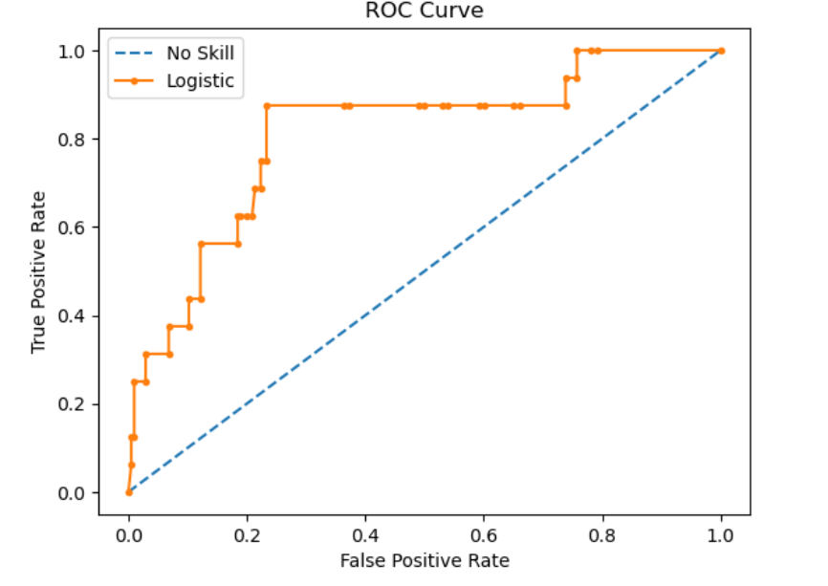
Logical Regression Model
ROC Curve.

Slide 15
K-Nearest Neighbors (KNN) Model
Independent columns are
ReasonForAbsence, DayOfWeek, WorkloadAveragePerDay, DisciplinaryFailure, Son, and Social Smoker
Dependent or Target columns are
Absenteeism time in hours
Dataset split: 80% training, 20% testing, random state set for reproducibility
Accuracy Score: 98.56%
F1 Score: 88.99 %

Slide 16
SUMMARY
Frequent Absentees: Some employees consistently showed high absence rates, requiring attention to potential personal or job-related issues.
Management Actions:
Conduct feedback sessions
Offer flexible/hybrid work options
Provide health & mental wellness support
Recognize consistent attendance
Encouraging Good Attendance: Employees with low absenteeism should be rewarded through appreciation, incentives, or growth opportunities.
Top Absence Reasons: Medical consultations, illness, and family issues were the most common.
Performance Insight: While some frequent absentees met targets, long-term absenteeism may affect team productivity, requiring thoughtful intervention.

Slide 17
Conclusion
Employee ID 3 was identified as the most frequently absent, while ID 35 had the fewest absences.
Medical consultation was the top reason for absence, followed by illness and family-related issues.
Despite frequent absenteeism, some employees maintained a good target achievement level, indicating the need for personalized follow-up.
Clustering analysis (K-Means) effectively segmented employees into Frequently Present and Frequently Absent groups.
Machine learning models like K-Nearest Neighbors (Accuracy: 92.79%) and Logistic Regression (Accuracy: 98.56%) showed strong predictive performance.

Slide 18
THANK YOU

